Slide 1
Phishing Awareness Training
By NAIYA PATEL

Slide 2
Introduction to Phishing
What is phishing?
Phishing is a type of cyberattack where attackers impersonate legitimate sources to trick people into revealing sensitive information like passwords, credit card numbers, or bank account details. They typically use deceptive emails, text messages, or websites to create a sense of urgency or fear, prompting victims to take actions like clicking malicious links or downloading harmful files.
TYEPS OF PHISHING:
---------------------------
Email Phishing Clone/Business Email Compromise
Spear Phishing
Smishing (SMS)
Vishing (Voice)

Slide 3
How to Recognize Phishing
-------------------------------------
Suspicious sender or domain
Urgent or threatening language
Mismatched URLs
Unexpected attachments or login prompts

Slide 4
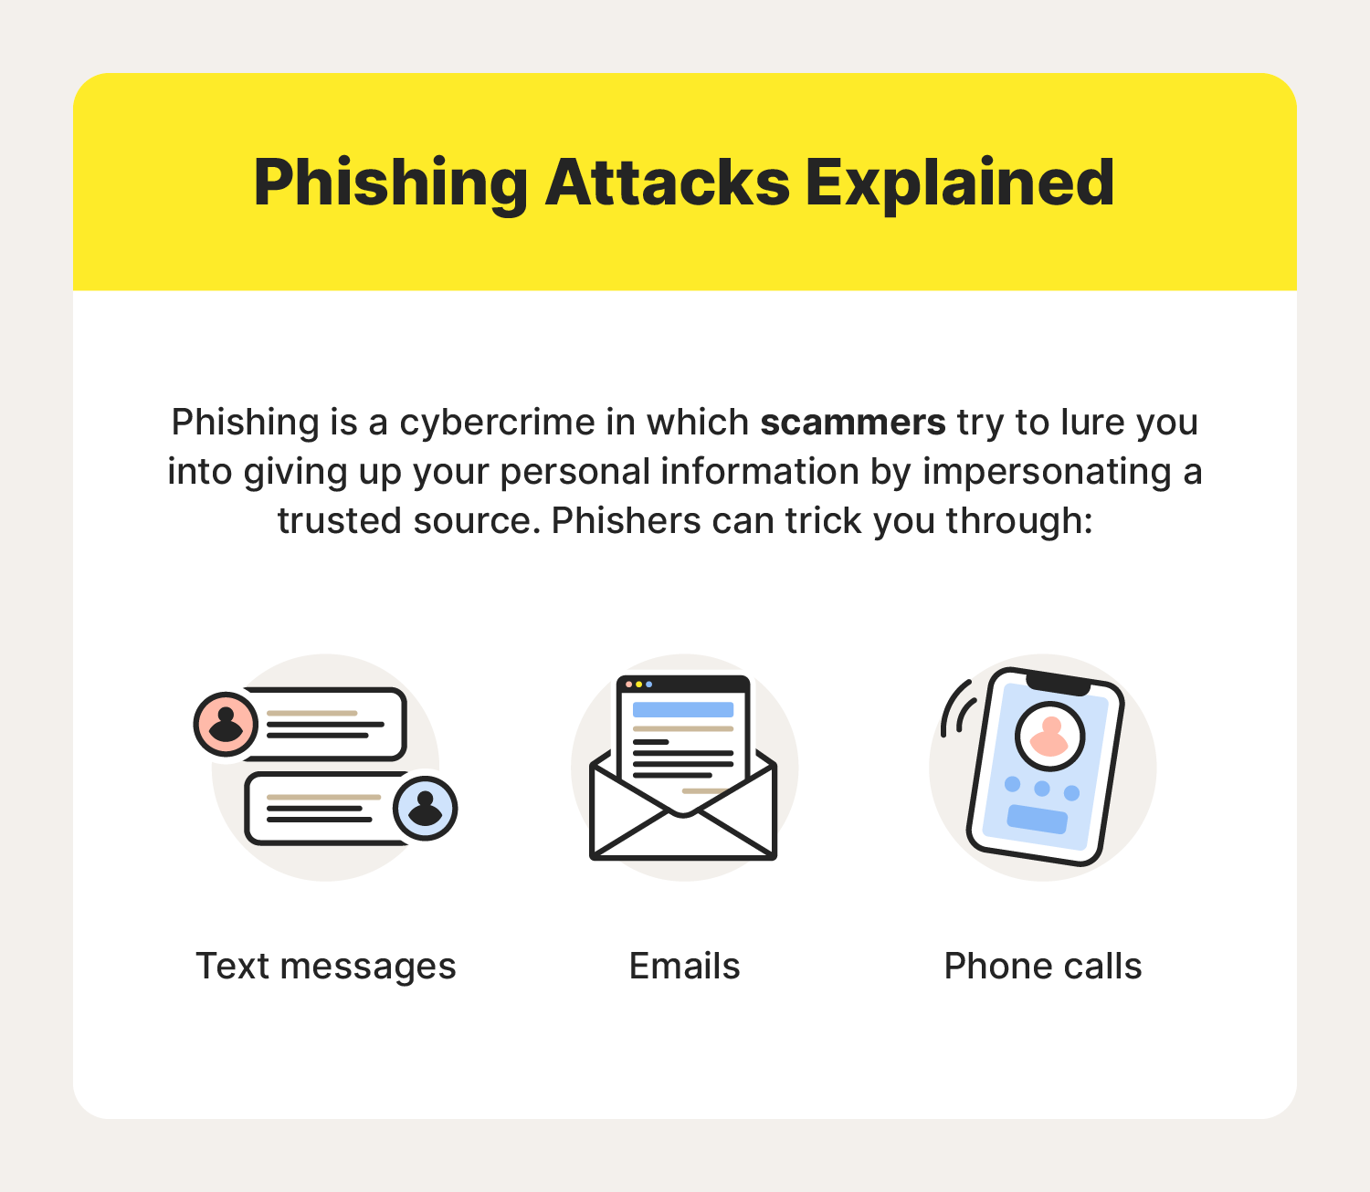
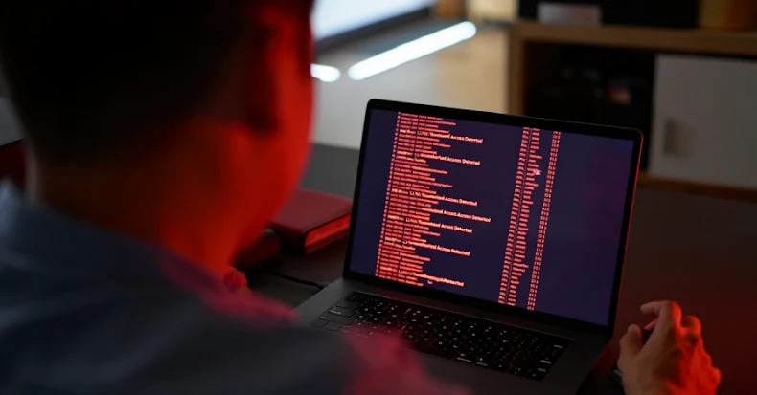
Show phishing emails for case

Slide 5
The threat actors behind a large-scale, ongoing smishing campaign have been attributed to more than 194,000 malicious domains since January 1, 2024, targeting a broad range of services across the world, according to new findings from Palo Alto Networks Unit 42.
"Although these domains are registered through a Hong Kong-based registrar and use Chinese nameservers, the attack infrastructure is primarily hosted on popular U.S. cloud services," security researchers Reethika Ramesh, Zhanhao Chen, Daiping Liu, Chi-Wei Liu, Shehroze Farooqi, and Moe Ghasemisharif said.
The activity has been attributed to a China-linked group known as the Smishing Triad, which is known to flood mobile devices with fraudulent toll violation and package misdelivery notices to trick users into taking immediate action and providing sensitive information.
These campaigns have proven to be lucrative, allowing the threat actors to make more than $1 billion over the last three years, according to a recent report from The Wall Street Journal.

Slide 6
STEPS FOR SAVE DATA
Incident Response Steps
Don’t click or reply
Report immediately to IT/security
Delete the message

Slide 7
THANK YOU

